Slide 1
The Fun Side of Coding - Snake Game
Presented By:
MD. Mostafijul Islam
SWE-242. ID: 242034012
Green University of Bangladesh
Presented To:
Ms. Aysha Banu
Lecturer, Department of SWE
Green University of Bangladesh

Slide 2
Table of contents
01
02
03
Introduction
Project Goal
Motivation
Introduce the idea behind the whole thing.
What was the initial goal behind the project.
What motivated the project to reach this outcome.
04
05
06
Technologies
Code Overview
Output/Result
What are the technologies we used in this project.
We will peek into the code and discuss about it a little.
Hopefully, we will get to see a demo of the project.
07
08
09
Limitations
Conclusion
Questions
What are the current of this project.
Some finishing thoughts about the whole journey.
Huhh!?!

Slide 3

01
Introduction
Introduce the idea behind the whole thing.

Slide 4
Introduction
History
Functions
First introduced in 1976 as part of the arcade game Blockade. It gained massive popularity when it was pre-installed on Nokia-6110 mobile phones in 1997. It’s simplicity made it made it a timeless classic and a cultural phenomenon.
Control a snake that moves around the screen to eat food. Each time the snake eats, it gets one point and it grows longer. The challenge is to keep the snake from crashing into itself or the walls while trying to eat as much as possible.

Slide 5
02
Project Goal
What was the initial goal behind the project.

Slide 6
Project Goals
Utilize
Learn
Practical use of all the programming concepts we’ve learned so far.
Learn how things come together to build a simple project.
Explore
Output
Face some obstacles, explore and learn something new.
Make a playable Snake Game that works as expected!

Slide 7
03
Motivation
What motivated the project to reach this outcome.

Slide 8
Motivation
Simplicity
Curiosity
Nostalgia
It was simple enough to get started with.
How some of the functionalities work!
The snake game is a part of my childhood.
It’s a Game
It’s Cool
Marks
Who doesn’t love to play a game?!?
Whole idea of building a game is suppa cool!
I had to do it, to get good marks!

Slide 9
04
Technologies
What are the technologies we used in this project.

Slide 10
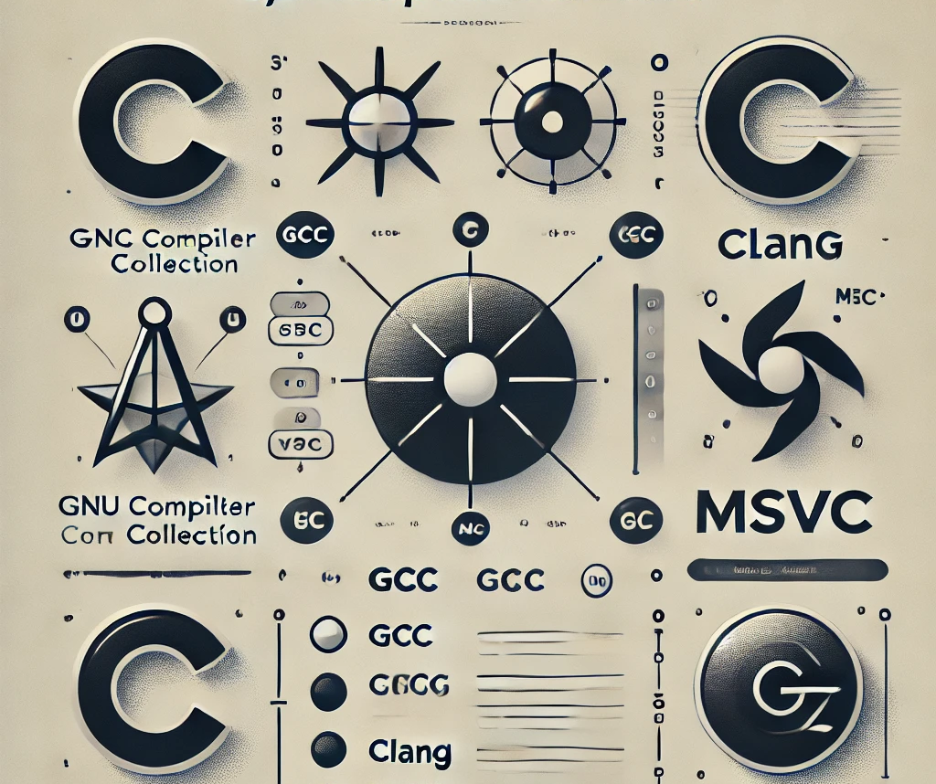


Technologies Required
Compiler
Curses Library
IDE
Need a C Language environment with a proper compiler setup.
We will need an external library linked curses.h also named as NCurses.
We will need an IDE where we can code and a terminal to run it on.

Slide 11
05
Code Overview
We will peek into the code and discuss about it a little.

Slide 12
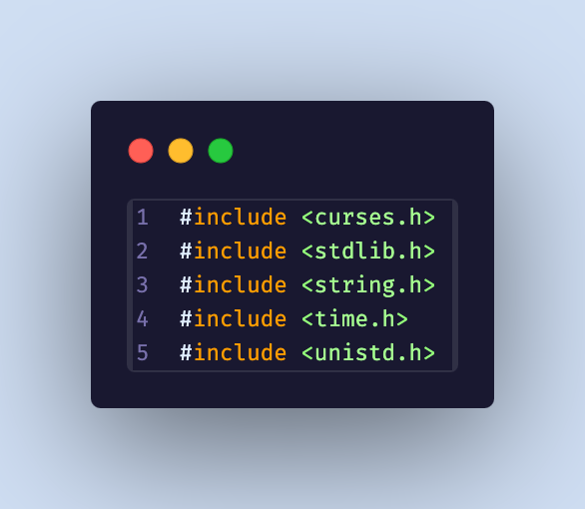
Include all the required Header Files
Access utility functions from
stdlib.h (rand, srand)
string.h (for strings)
time.h (too seed srand)
unistd.h (to freeze/sleep)
curses.h (NCurses tools)

Slide 13
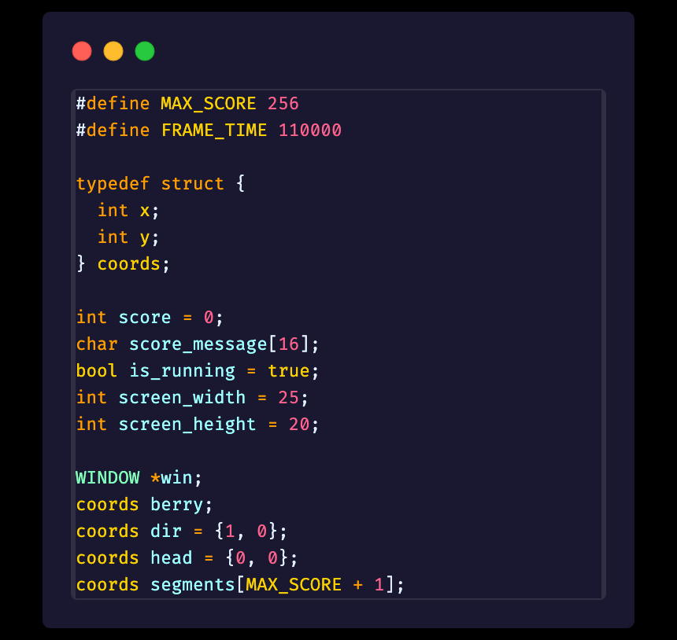
Define some core states of our Game
States are Values that we depend on while the game runs.
For example what’s the score right now. How long the snake is. Where exactly the snake is. Where’s the berry right now, etc.

Slide 14
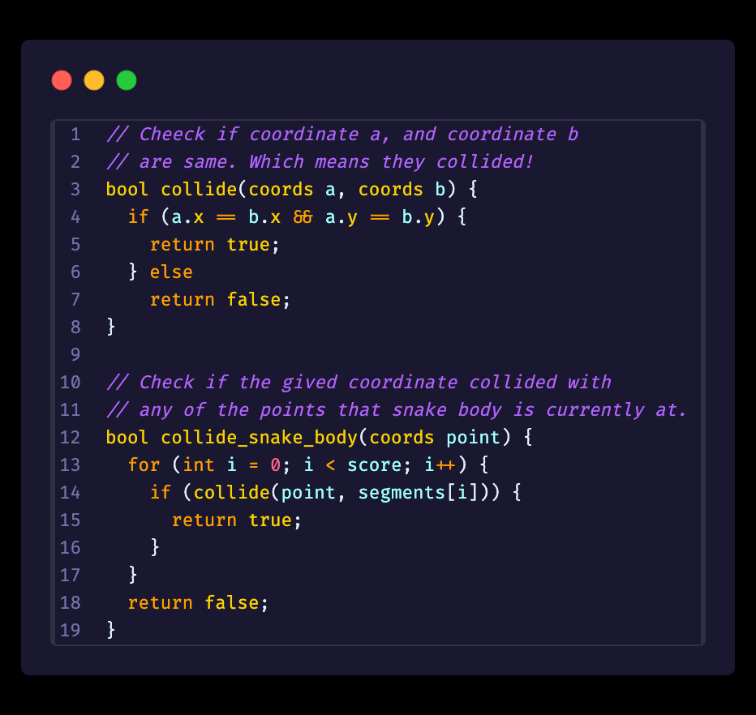
Some of the Functions we created.
Remember the struct we formed
That helps us store two values x and y together. And we can use it as an (x, y) coordinate system. And use functions to check necessary conditions.

Slide 15
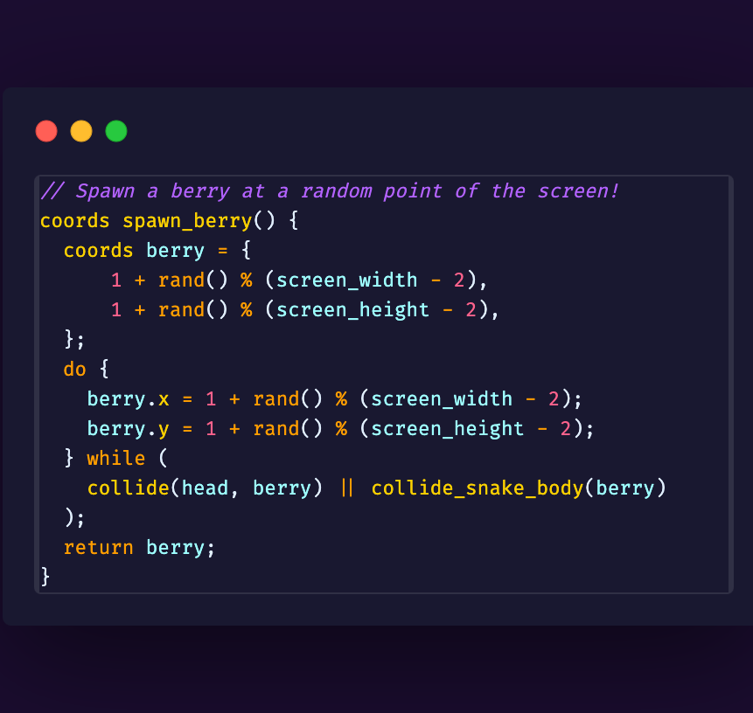
Some of the Functions we created.
Function to decide coords for the berry.
Returns a random coordinate within the screen limit. Where we can place our berry.

Slide 16
06
Output/Results
Hopefully, we will get to see a demo of the project.

Slide 17
Preparation Steps
gcc snake_game_project.c -lncurses -o game.out
The -lncurses flag links the Ncurses library, and the -o game.out option
specifies the name of the output executable file.
./game.out
Let’s finally run our game by calling the executable file we just made. And put that snake on the ruuunn!!

Slide 18

Snake Game

Slide 19
07
Limitations
What are the current limitations of this project.

Slide 20
Limitations
Limited Score
Static Speed
Currently we’re starting with a fixed number of slots for our snake.
Currently our game starts with a fixed speed used as fps.
No Persistence
Console Dependency
Currently we’re not storing any user data or high score.
Our game is completely console dependent.

Slide 21
Limitations & Future Work
Limited Score
Currently we’re starting with a fixed number of slots for our snake.
Static Speed
Currently our game starts with a fixed speed used as fps.
No Persistence
Currently we’re not storing any user data or high score.
Console Dependency
Our game is completely console dependent. Which limits functionality.

Slide 22
08
Conclusion
Some finishing thoughts about the whole journey.

Slide 23
Conclusions
Hands on Experience
Learned new Functionalities
More to Experiment
Got to use the tools and techniques we’ve been learning throughout the course.
Explored some new tools, methods and terminologies on the way.
Lot more to implement and import and just tons of possibilities.

Slide 24
Any Questions?!?🤔

Slide 25
Game Over 🪦💐
Thank You! 💙✨

